Slide 1
From Climate Crisis to Climate Justice
Video 3:
Community work strategy & action
Dr Jamie Gorman

Slide 2
Thinking structurally, acting strategically
Step 1 | Detail | Examples
Creating space for local dialogue How are people experiencing the issue? What are the common concerns? | Space to share, reflect, explore and discuss as a community | A community food sharing event. A coffee morning. A trip to a local community garden.

Slide 3
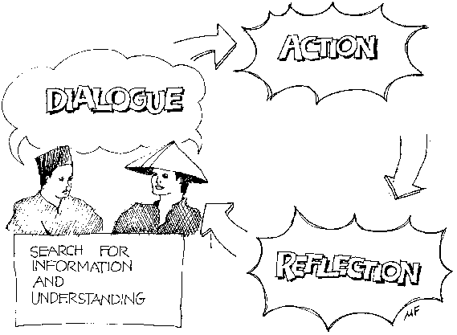
Conversations & dialogue

Slide 4
Paulo Freire & dialogue
Stage one: Listening
Begin by listening informally to people. What are their concerns? How does the climate crisis affect their lives? What are the challenges, injustices, inequalities – as well as opportunities and possibilities - that arise in the peoples’ worlds. Freire called this stage a ‘Listening survey’.
Stage two: Key issues
Identify the recurring, key issues of most concern to people. Freire called these ‘generative themes’ because they have the potential to generate the energy for action with a group.
Stage three: Create prompts
Identify some prompts such as images, poems, songs/music videos, stories or movie clips. These prompts capture and reflect back to people the ‘generative themes’. Freire called the prompts ‘codes’ because they have meaning encoded in them.
Stage four: Dialgoue
Use the prompts to facilitate a creative dialogue about the ‘generative themes’. Workers focus on posing questions and inviting reflection from diverse voices.
Stage five: Action
Key to the Freirean approach is supporting people to feel empowered to act in the world and address the issues that affect them. Through the process of dialogue, a response to the issues might emerge from the community and workers can support them to take action together.

Slide 5
Thinking structurally, acting strategically
Step 2 | Detail | Examples
Map policies, actors and drivers What current policies address this issue? Who are the key players in this issue? What are the drivers and root causes? | Through dialogue and strategic planning tools support the community to develop an analysis of the issues, root causes and possible responses | The work of the Government’s food policy working group Recent research on food poverty in Ireland The “Social Determinants of Health” framework and Healthy Ireland

Slide 6
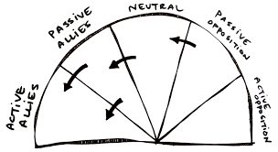
Strategic mapping

Slide 7
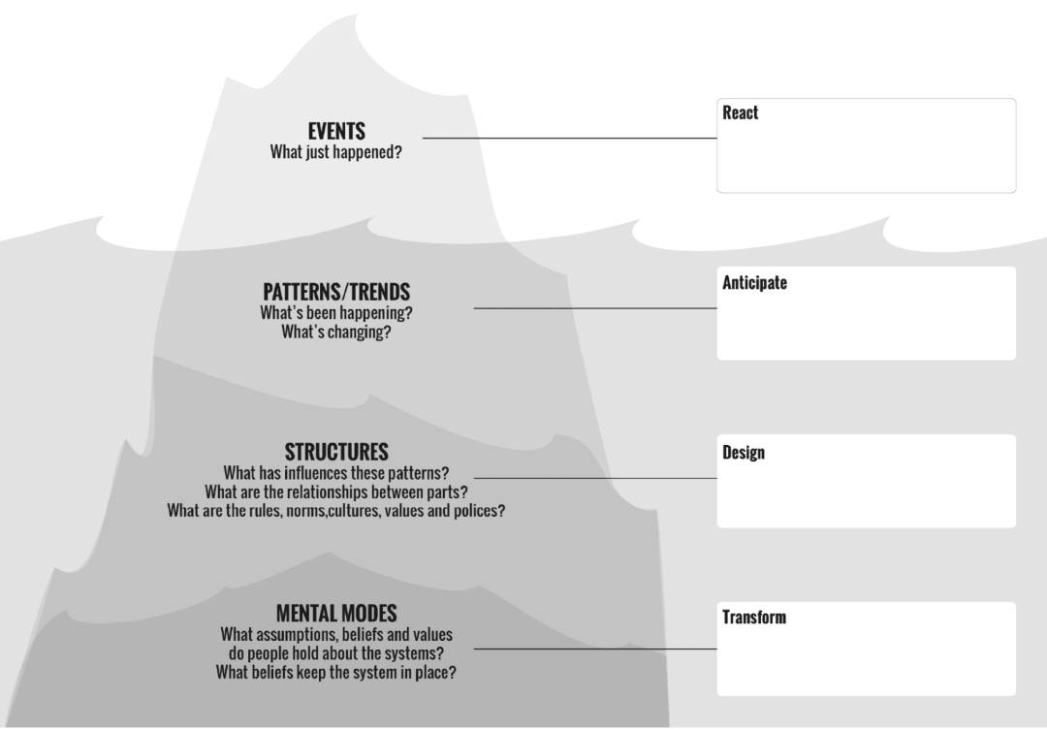
Strategic mapping

Slide 8
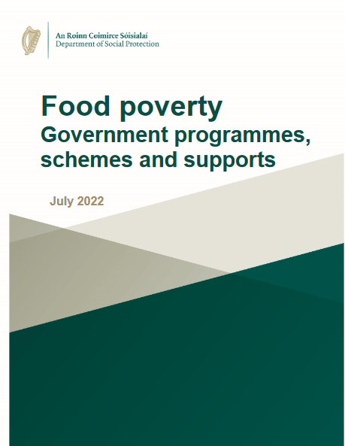
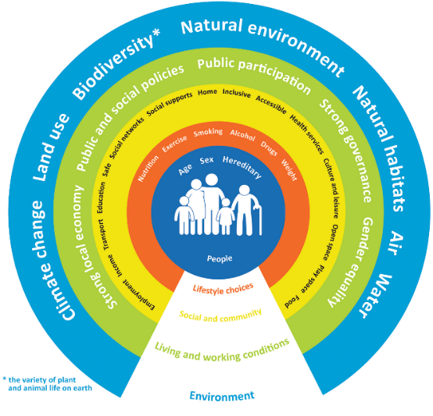

Slide 9
Thinking structurally, acting strategically
Step 3 | Detail | Examples
Identify local actions What can the community do locally to address the issue? | Practical collective action they can take locally to address food poverty. Learning from and sharing with other communities. | Starting a community garden or a Community Supported Agriculture project Community cooking and food sharing events

Slide 10
Local practical action

Slide 11
Thinking structurally, acting strategically
Step 4 | Detail | Examples
Build alliances to work for structural changeup action How can we make our voices heard and create political and policy change? How can we work with others to have a bigger impact & influence change? | Connect with other communities, NGOs and campaigns to network, build alliances and identify common ground for collective advocacy and action. | Engaging with the Healthy City & Counties Network. Attending the annual National Social Inclusion Forum. Joining Tallamh Beo and campaigning for a fair food system. Raising issues through the PPN or Local Environmental Network. Joining (or starting) a local Food Policy Council

Slide 12
