Slide 1
From Climate Crisis to Climate Justice
Video 2:
Key concepts & Policy context
Dr Jamie Gorman

Slide 2
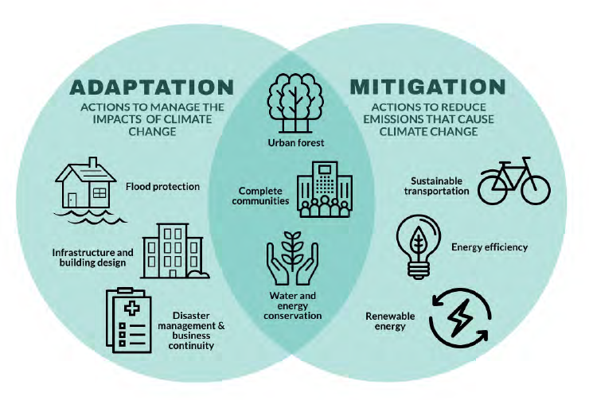
Adaptation & mitigation

Slide 3
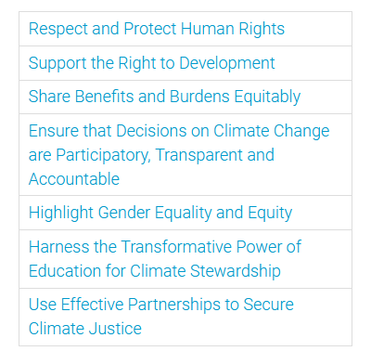
Climate Justice
The Mary Robinson Foundation –Climate Justice

Slide 4
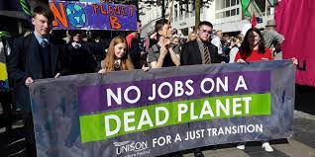
Just transition
Emerged from the trade union movement in the 1970s - today focuses on protecting workers rights in the shift away from carbon intensive industries
Recognised in the 2015 Paris Agreement.
A just transition emphasises justice and equity in climate policy making, placing the rights of workers and the most marginalised front and centre in the energy transition.

Slide 5
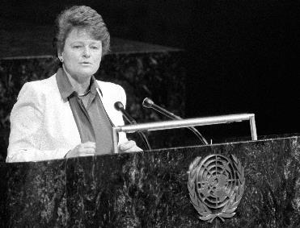
Sustainable development
"Sustainable development is development that meets the needs of the present without compromising the ability of future generations to meet their own needs”
Just sustainability: “to ensure a better quality of life for all, now, and into the future, in a just and equitable manner, while living with the limits of supporting eco-systems”
Julian Agyeman’s Just Sustainabilities

Slide 6
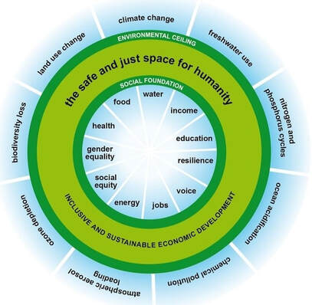
Doughnut economics
Key challenge of sustainable development is to remain within the ‘doughnut’ – meeting the basic needs and protecting the human rights of all, without overshooting the planetary boundaries.
TED Talk from Kate Raworth

Slide 7
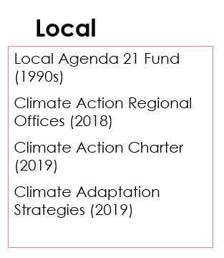
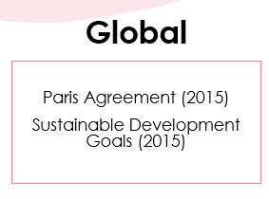
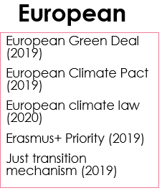
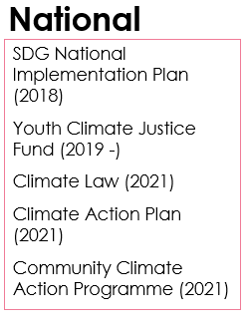
Evolving policy landscape

Slide 8
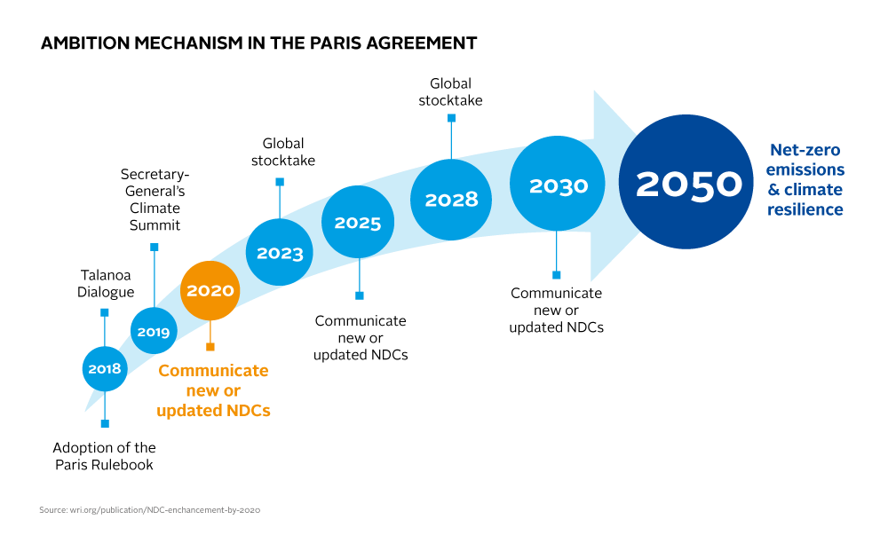
Policy context – Global
Paris Agreement (2015) sets the pathway to net zero emissions by 2050

Slide 9
Policy context – Global
The IPCC provides the consensus scientific evidence on climate change to support governments and policy makers
The UNFCCC established structure for international climate policy decision making

Slide 11
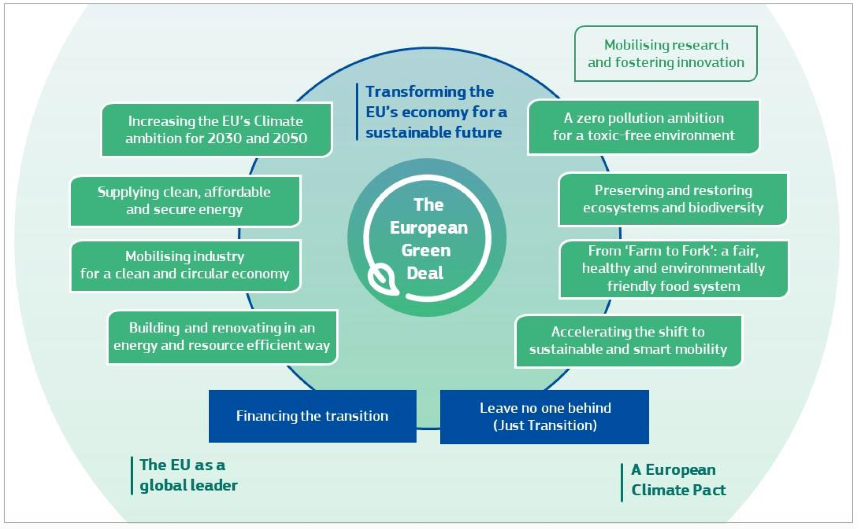
Policy context - European

Slide 12
National policy
Legal framework: Climate action & Low Carbon Development Act 2021
Policy framework: Climate Action Plan – Updated annually

Slide 13
Key policy points
National climate objective
To be climate resilient, biodiverse rich, environmentally sustainable and climate neutral no later than 2050.
Carbon budget
The total amount of emissions, measured in tonnes of CO2 equivalent that may be emitted by the country during a specific time period.
Sectoral emissions ceilings
The total amount of emissions permitted by each sector of the economy during a specific time period.

Slide 14
Ireland’s mitigation plan
2021–2025
4.8% emissions reductions per annum
2026–2030
8.3% emissions reductions per annum
2030
By 2030: 51% emissions reductions
2050
By 2050: Carbon neutrality

Slide 15
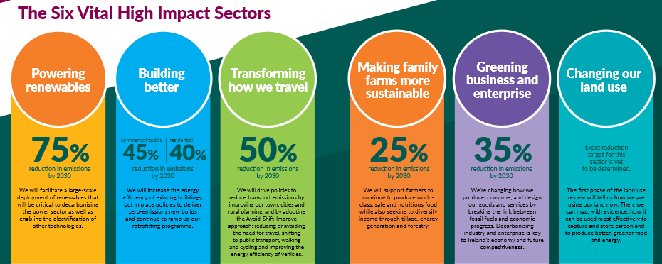
Sectors involved

Slide 16
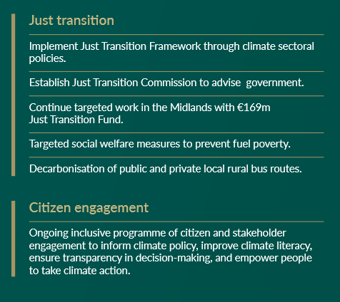
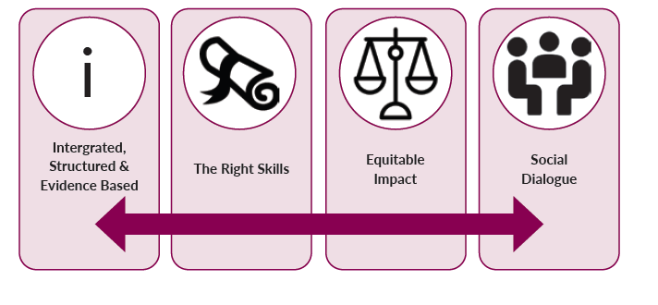
Just transition nationally
The government’s Just transition principles
Climate Action Plan 2023

Slide 17
Applying a climate justice lens, what are the key issues in climate policy?

