Slide 1
From Climate Crisis to Climate Justice
Video 1:
The climate CRISIS & WHY IT IS AN ISSUE FOR COMMUNITY WORK
Dr Jamie Gorman

Slide 2
Workshop aims
Feel resourced to make sense of climate issues relevant to practice
01
Feel ready to take practical action for climate justice in your work.
02
Feel confident to campaign for just climate policy with like-minded practitioners.
03

Slide 3
Workshop structure
What is the climate Crisis & why is it an issue for community work
Key concepts and policy context
Community work strategy and action

Slide 4
Symbols in the slides
A link found in the toolkit.
An additional resource
A point to pause and reflect

Slide 5
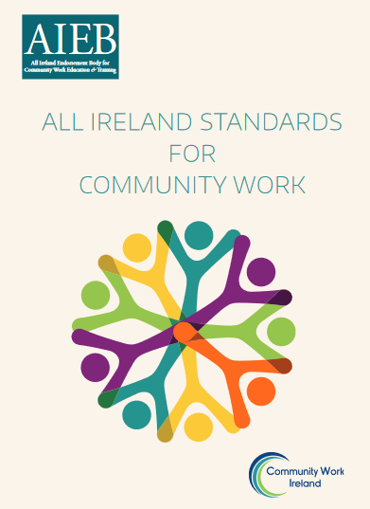
Social Justice & Sustainable Development in the All- Ireland Standards
‘Promoting a sustainable society involves promoting environmentally, economically and socially sustainable policies and practices.
It requires the practice of thinking globally and acting locally for the present and the future.
In pursuing social justice and sustainable development, community work is concerned with the redistribution of wealth, power and resources in society.
It seeks to mitigate against the effects of climate change and ensure equal access to a good quality environment for all.
These rights are all interrelated, interdependent and intersectional’ (p.15).

Slide 6
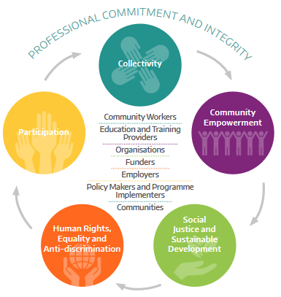
Climate justice work should involve the application of all community work values
All Ireland Standards

Slide 7
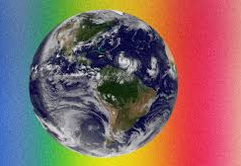
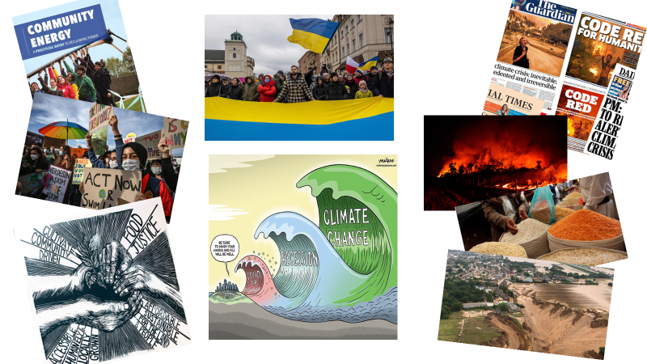
“When I think of the climate crisis, I feel…”
Make a list, write a short paragraph or draw a picture

Slide 8
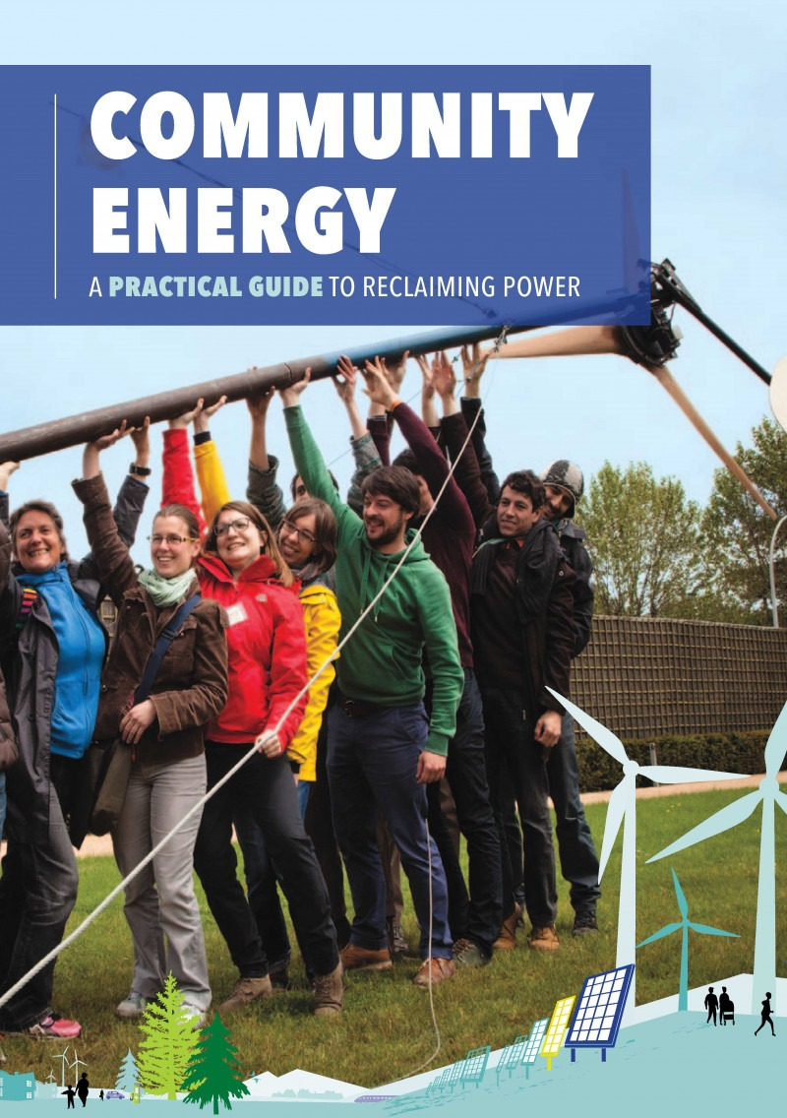
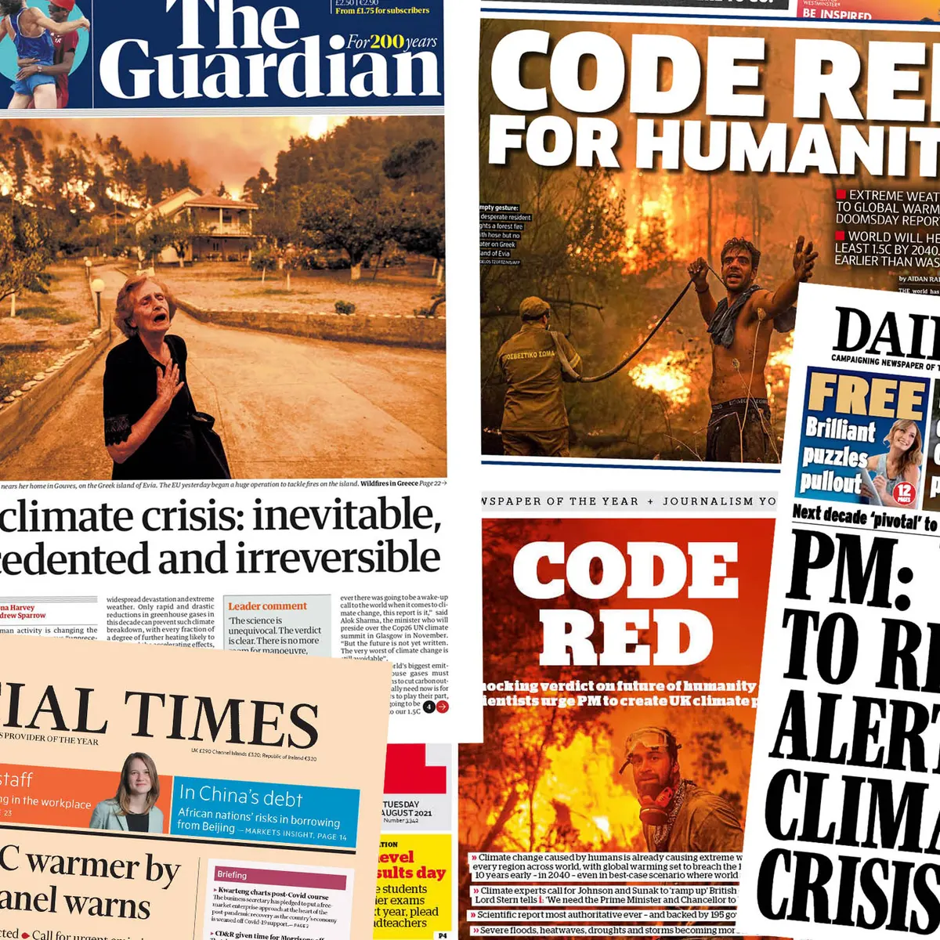
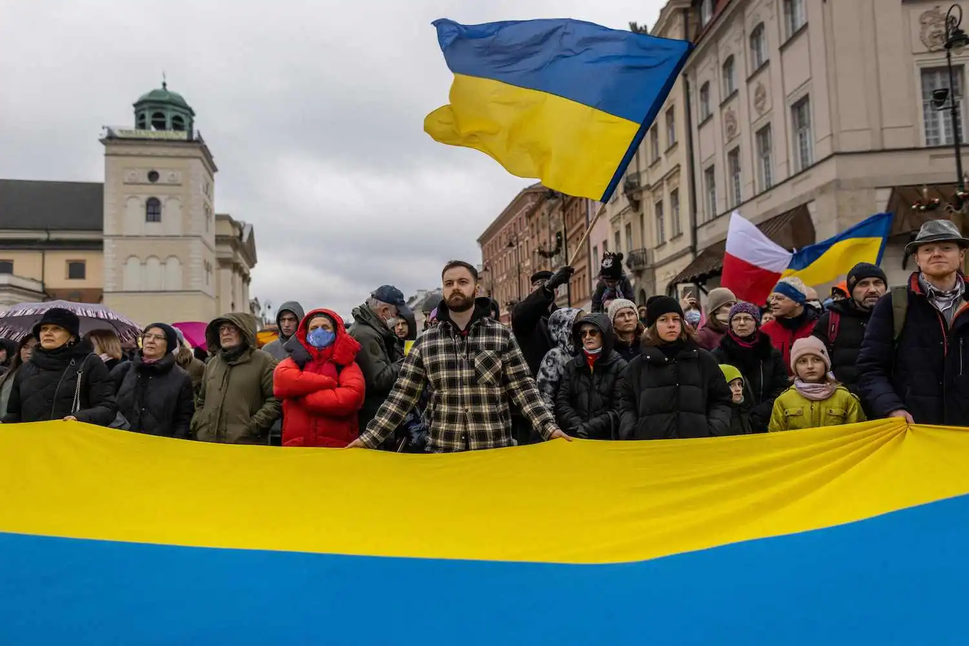
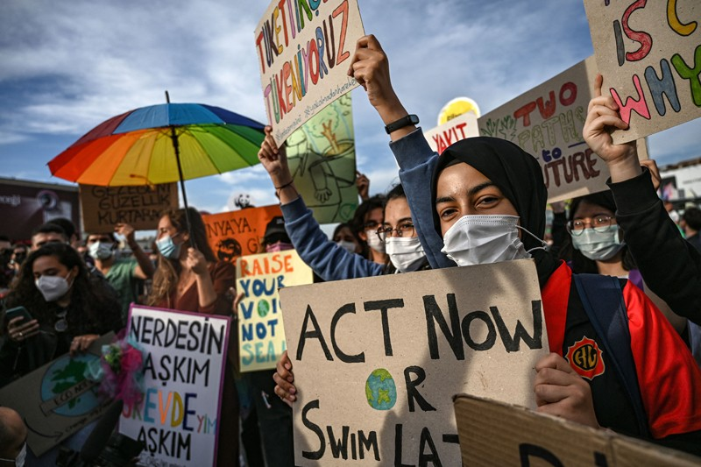
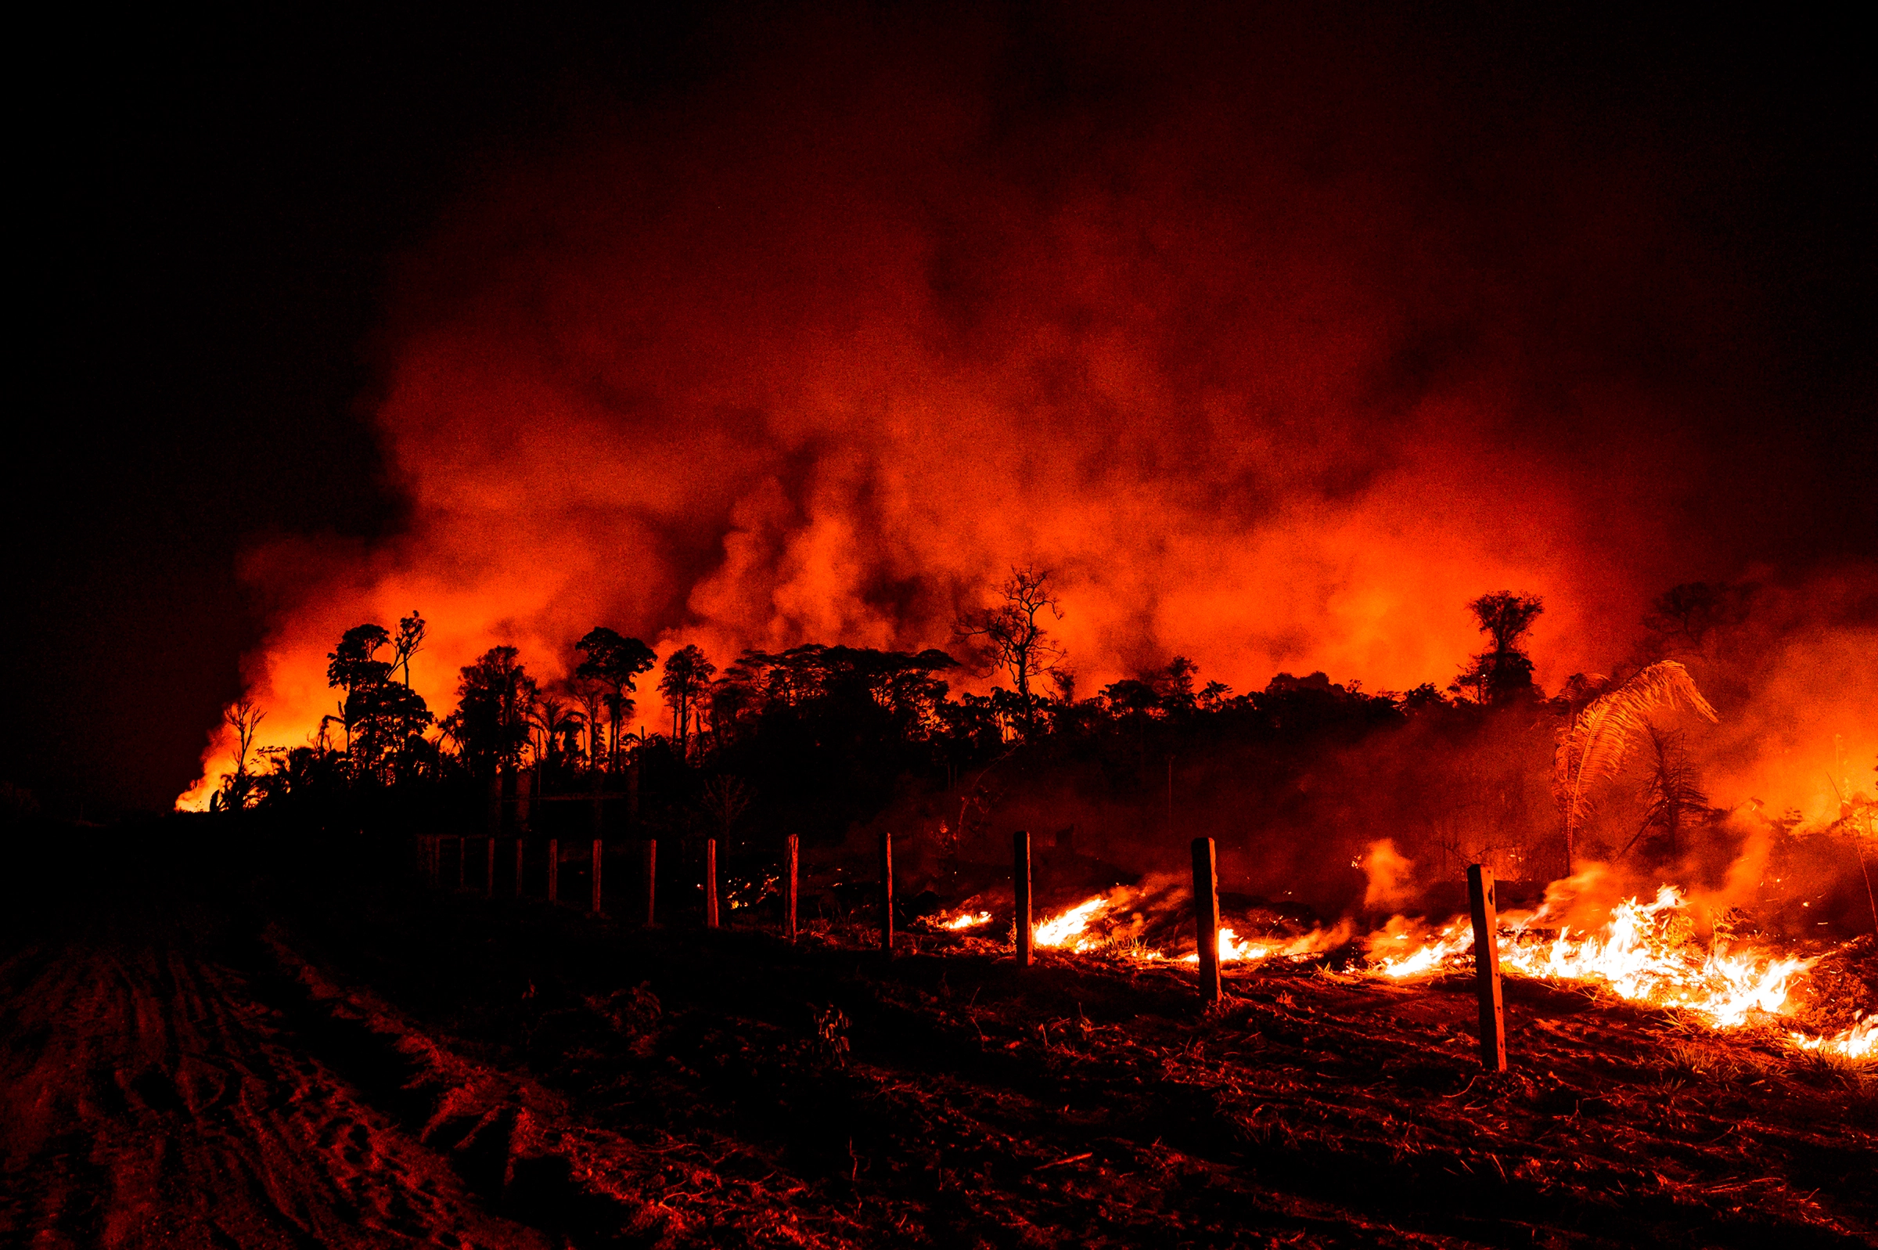
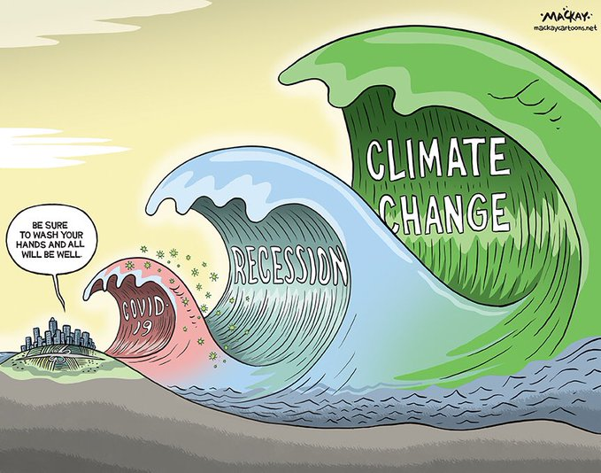
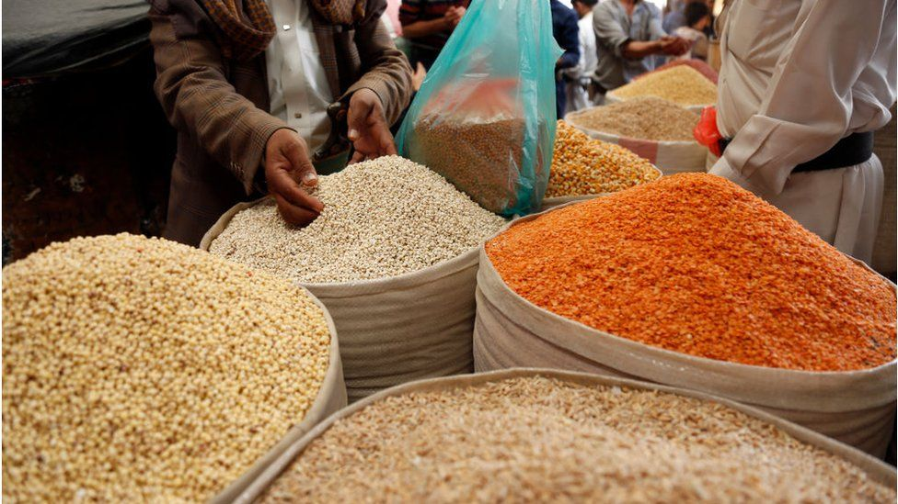
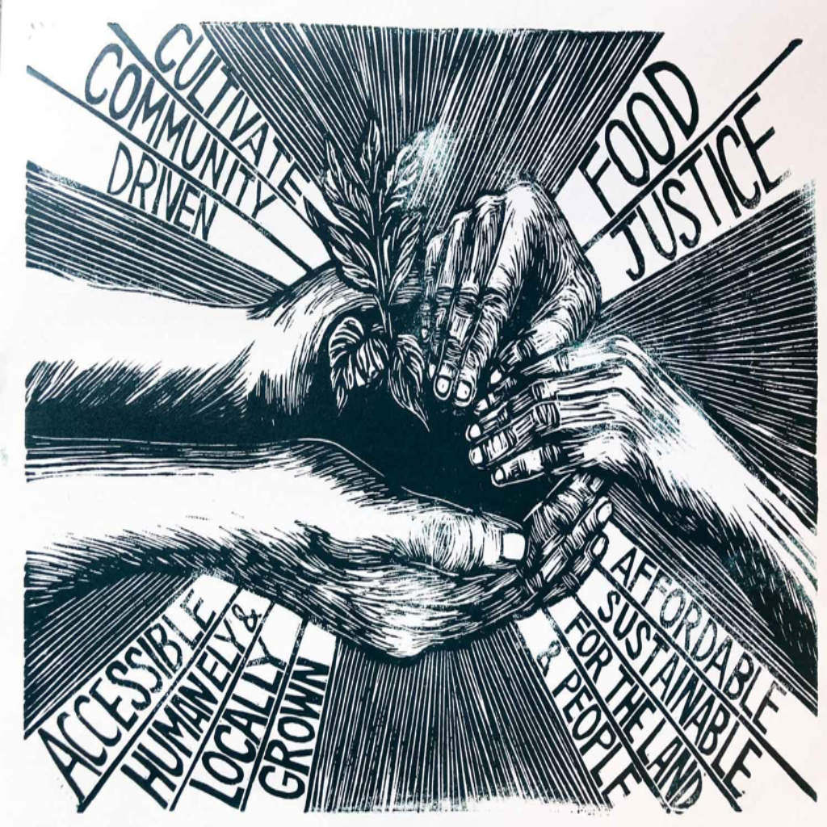
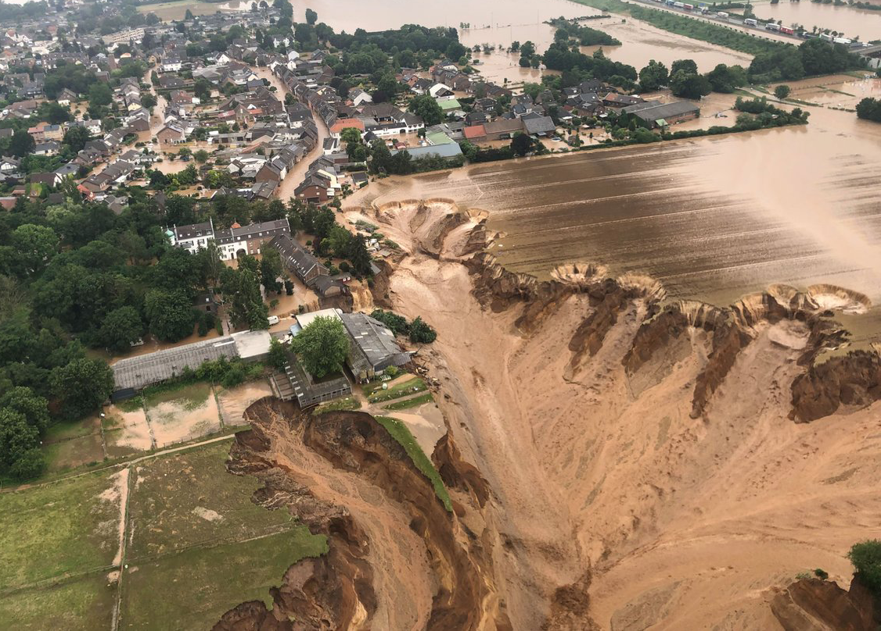

Slide 9
“Things that give me hope and energy to act include…”
Make a list, write a short paragraph or draw a picture

Slide 10
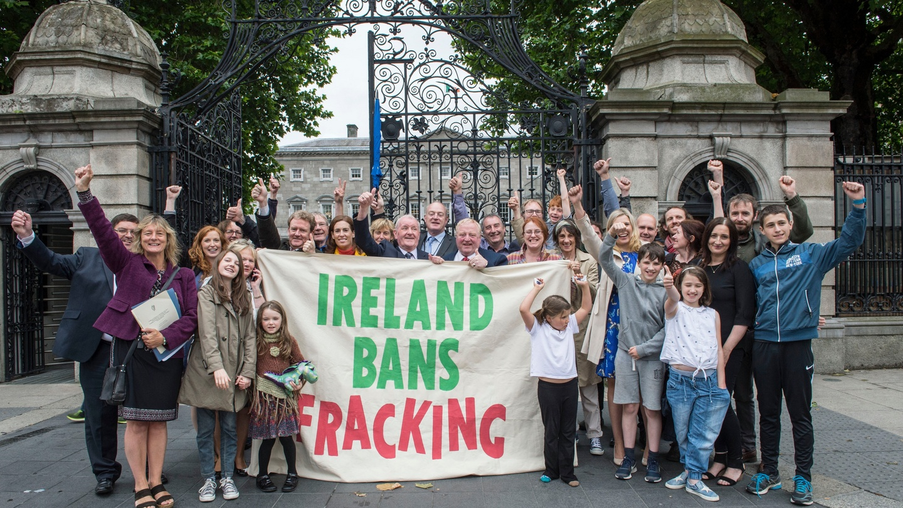
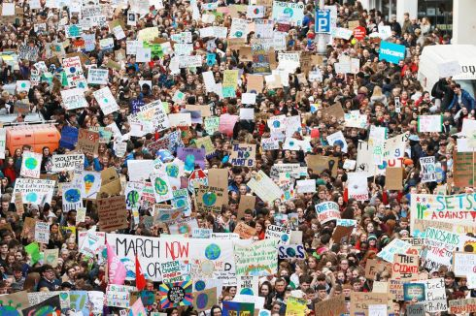
Youth Climate Strikes, 2019
Ireland bans fracking, 2017

Slide 11
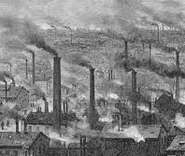
What is the climate crisis?
The impact on ecosystems & societies of the changing climate, which is caused primarily by the burning of fossil fuels.
Driven by industrialisation, industrial agriculture, global trade and military expansion = Capitalism and colonialism
19th Century air pollution

Slide 12
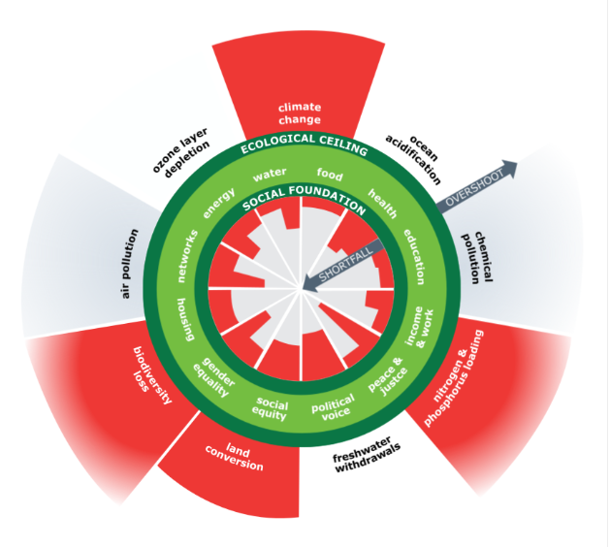
Over-stretching planetary boundaries
Planetary boundaries are the limits of the earth’s ‘safe operating space’ which humans must remain within to ensure healthy ecosystems can maintain life on earth
Stockholm Resilience Institute

Slide 13
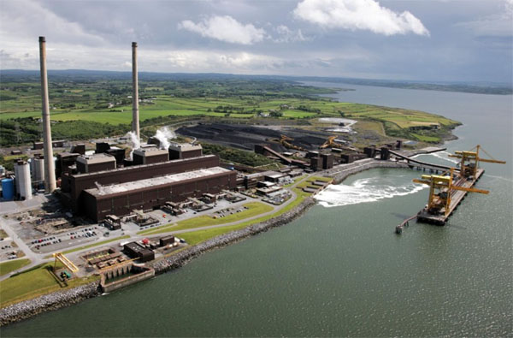
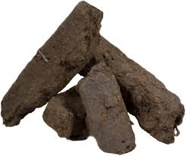
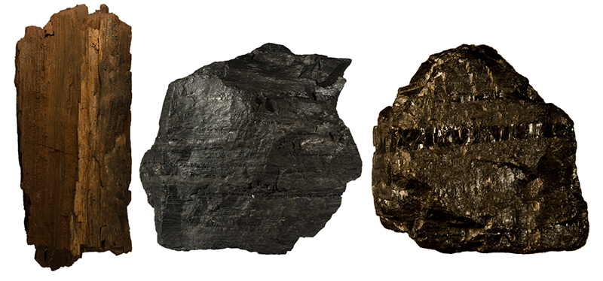
Fossil fuels
Moneypoint coal-fired ESB station burns coal from the Cerrejón mine in Colombia
Fossil fuels explainer

Slide 14
Cerrejón mine in Colombia
Global Witness report on human rights abuses at Cerrejón

Slide 15
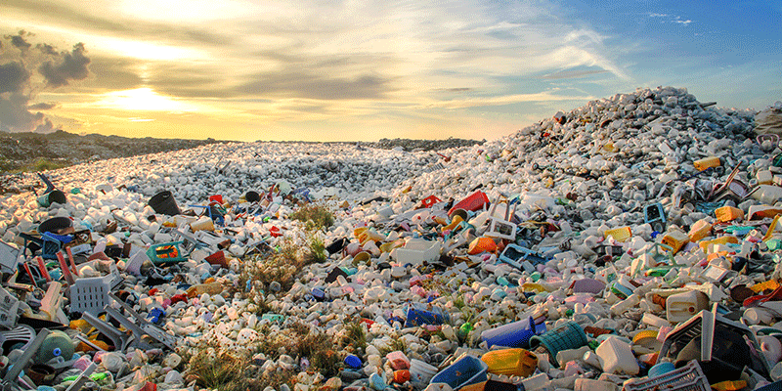
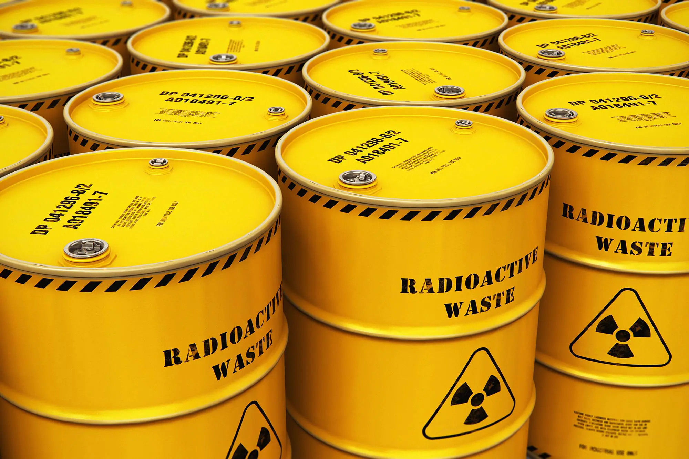
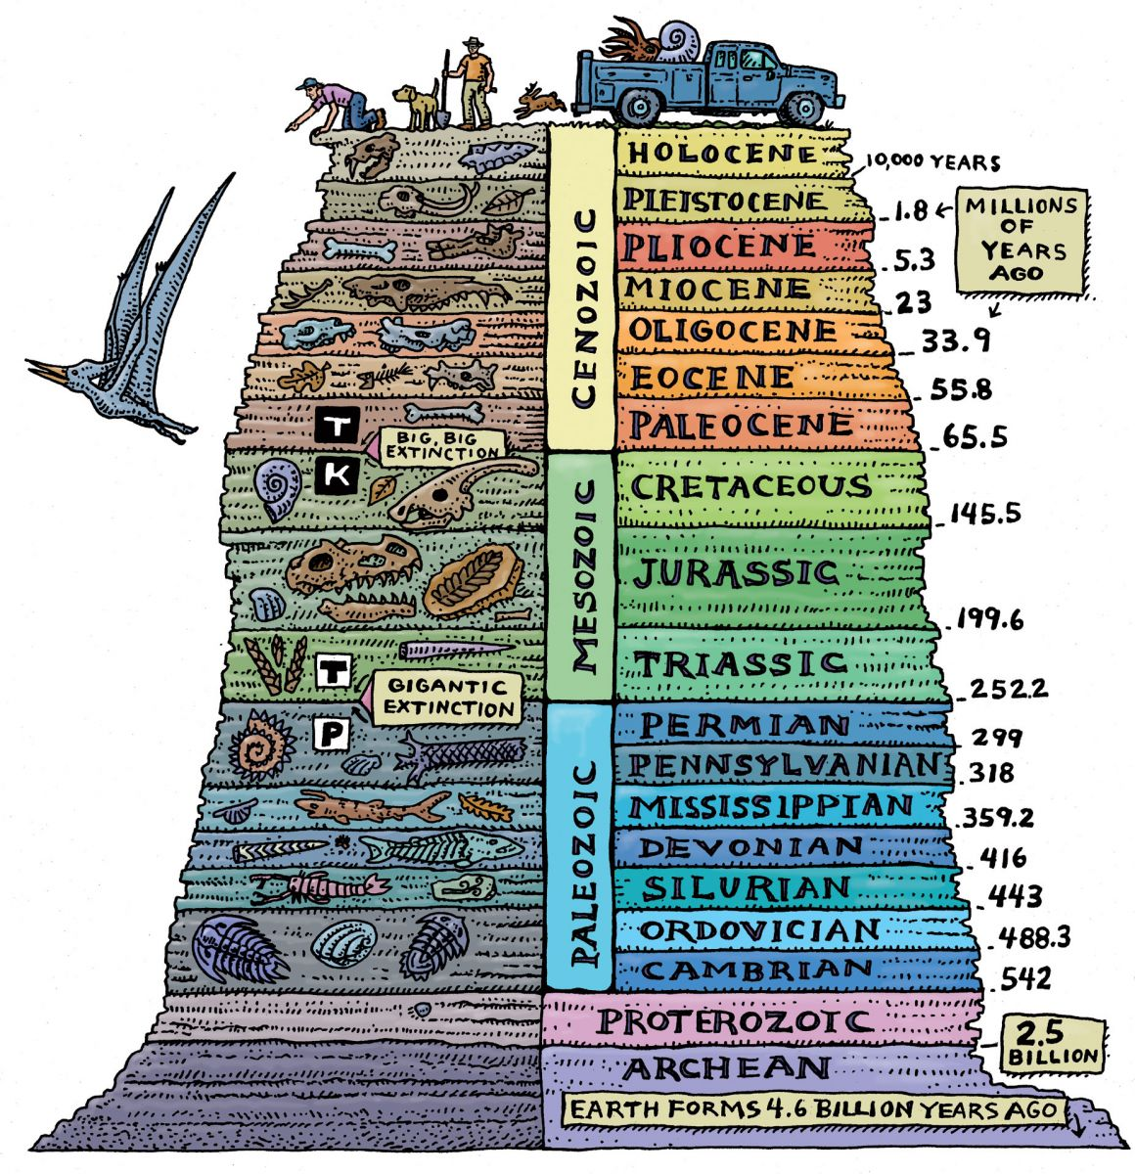
The anthroprocene

Slide 16
Climate crisis and justice
“Climate justice means… tackling the root causes of the climate crisis – including unsustainable production, consumption, and trade – while making progress towards equity and the protection and realization of human rights,”
- Menka Goundan, Women’s Fund Fiji,
Global South feminist perspectives on climate justice

Slide 17
The Climate crisis: a triple injustice
Climate crisis disproportionately impacts marginalised and disadvantaged groups in Ireland and globally:
They have often done least to cause the crisis in terms of emissions.
They are most exposed to climate risks.
They have the least resources to respond to the crisis with resilience.

Slide 18
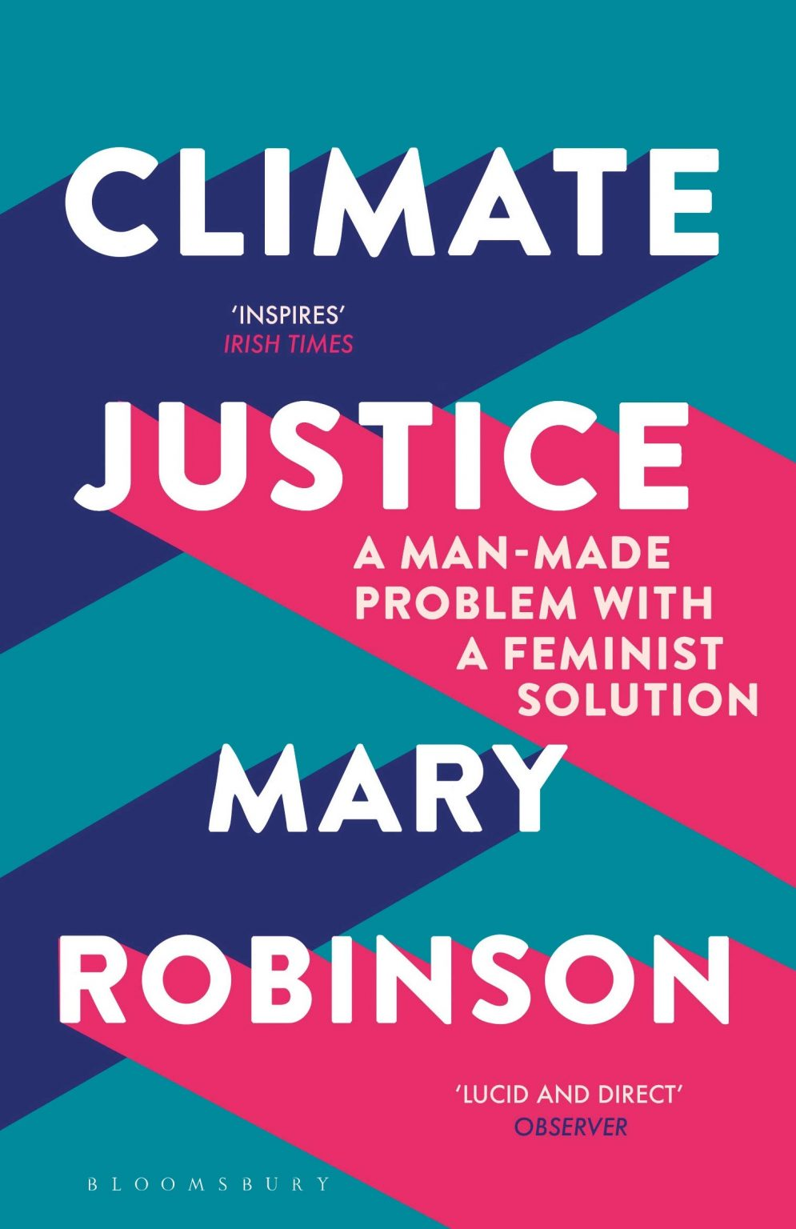
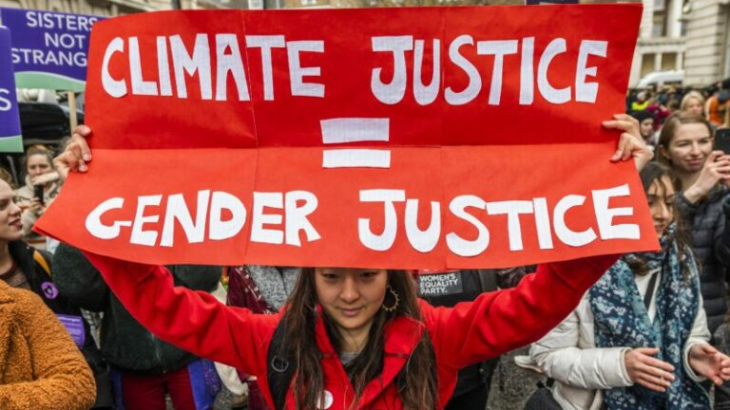
The climate crisis requires a focus on gender justice

Slide 19
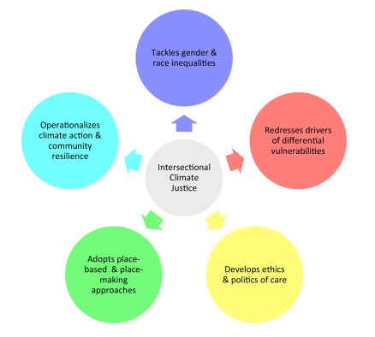
The climate crisis is an intersectional crisis
Amorim-Maia & others (2022) A conceptual framework for intersectional climate justice

Slide 20
A climate justice lens: spotting bull****
Climate policies that negatively affect marginalised groups
Proposed solutions which are unaffordable
Focusing on individual responsibility letting big polluters off the hook
Greenwashing that promotes false solutions.

Slide 21
How does this resonate? How do you relate it to your own work?

