Slide 1
Community Development Mental Health Network
Our Values

Slide 2
Our Vision
‘A society where people are free from coercion, where mental health and wellbeing, and the recognition of distress and madness, are valued in the interests of the communities in which we live, and where healing, empowerment, inclusion, and equality are celebrated and realised.

Slide 3
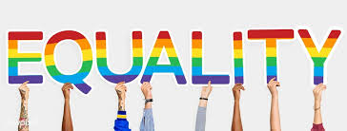
Equality
The work of the Mental Health Network is informed by people with lived experience, from whatever the experience of maginalisation, this does not mean treating everyone the same rather recognition of different starting points and respect for individual and intersectional experiences and identities.
We recognise that social class and social context are key determinants to be taken into account including social background and educational background, employment status, income level and levels of agency in relation to decision making protection and promotion of rights. We promote respect for individual and intersectional experiences and identities. We believe in equality of access and opportunity, acknowledgement of people's situation and systemic barriers they may face in terms of basic human rights, education, employment, health, housing, and education, accessibility to appropriate and adequate mental health services, documentation and rights there in. We believe we have an equal right to be heard and listened to, accepting the value of differing perspectives and lived realities.

Slide 4
Full Effective Participation and Power Sharing
Participation is rooted in the self identification of needs and interests, the formulation of responses by the community or group concerned and is central to their ability to continue to influence outcomes.
We believe that mental health policies, services and programmes will not and cannot be effective without the meaningful participation of people with experience of mental and emotional difficulties and their families/carers in their design/co-design, implementation and monitoring.
We support the ideals of participative democracy i.e. the development of integrated and participatory forms of planning and organising, which identifies and addresses barriers to participation and promotes, supports and resources universal access and the active engagement of mental health communities on an equal footing with state agencies and others in decision making structures and processes. Enshrined in this is a commitment to ensuring that dominant voices don't control or determine the narrative, that power is shared and that choice to participate or not is respected.

Slide 5
Empowerment
Empowerment is about bringing people together, to share lived experiences and to collectively look at how they can work together to influence service delivery, policies and practices. Empowerment is about the supporting and building the capacity of individuals to ensure the loci of control being within the person but also recognising the need to work together to challenge structural inequalities and bring about systemic change.
Empowerment is about giving people the self-belief and confidence, not just individually but collectively, to look at the systems that create inequalities in society, which in turn impact on people’s emotional wellbeing. Another aspect of empowerment, a mental aspect, is of it is the loci of control being firmly within the person and the person possessing a well-balanced list of priorities.

Slide 6
Human Rights and Social Justice
We are seeking a society where the human rights of those with mental health difficulties are understood, respected and realised with zero tolerance of discrimination and violence. We promote the human rights mechanisms and frameworks, processes and standards for the protection and promotion of human rights for all nationally and internationally. In particular, we call for implementation of the UN Convention on the Rights of Persons with disabilities to promote and protect the rights of disabled people and those with mental health difficulties. We promote the right of people with mental health difficulties to make their own choices and claim their rights supported through accessible information and resources.
We are seeking a just society which has at it’s core, policies and practices that challenge injustice, poverty, inequality, discrimination and social exclusion, promotes accountability and values diversity of identities and approaches. A society that recognises the social determinants of mental health difficulties and ensures that all people can benefit from an equitable distribution of wealth, opportunities and privileges in society.

Slide 7
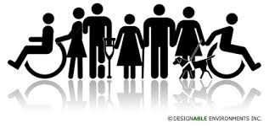
Non - Discrimination
Non-discrimination is recognising and challenging societal barriers and biases (stigma, racism and dual diagnosis) to peoples’ participation, embedding and providing supports to ensure peoples’ right to be included in society and right to enjoy the highest attainable standard of physical and mental health are met.

Slide 8
Freedom from violence and coercion
Freedom from violence and coercion means full operation of UNCRPD in relation to freedom from torture, and right to make a decision on our own lives health and health care.
We work to change systemic violence in societies, communities and mental health services. We support choice, autonomy and alternatives to coercion in mental health services.

Slide 9
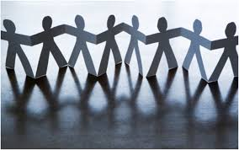
Collectivity
This Network believes in collectivity, working together to build our shared analysis and understanding, working for collective outcomes and taking action together in pursuit of our vision using the power of a collective voice and goal. We will build solidarity, organise and take action for change. We will Identify and seek to remove barriers to participation and promote the active participation of our members recognising the wealth of the diverse, creative and positive resources within the Network.

Slide 10
Growth and transformation
This Network intent on shifting the preexisting bio-psychiatrically centred paradigm in mental health care provision, particularly in communities. Underpinning this is an expectation of a transformation in how people view mental health difficulties/emotional distress & madness and subsequently respond as individuals, organisations and communities. This paradigmatic shift assumes an inevitable personal and systemic growth.

Slide 11
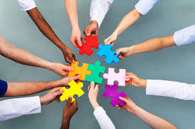
Respect (for difference and evolving capacities)
Recognising and valuing the diversity of experience and knowledge within the Network, including diversity in terms of ethnicity, sexuality, gender, socioeconomic status, impairment and also in terms of the difference of lived experiences.

Slide 12
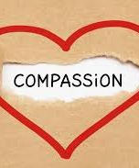
Compassion, Hope, Integrity, Transparency
Placing Compassion, Hope, Integrity & transparency centrally within the Networks’ values we respond to distress, diversity and difference with evolving understanding, encouragement, honesty and openness.

Slide 13
Trauma informed communities
Trauma results from an event, series of events, or set of circumstances that is experienced by an individual and/or communities as physically or emotionally harmful or threatening and that has lasting adverse effects on the individual’s/communities functioning and physical, social, emotional, or spiritual well-being [1].
Community in this instance may refer to communities of; identity/geography/practice/professional providers of care and others.
Working in a trauma-informed ways means acknowledging and accepting the impact of trauma and being aware of how unresolved trauma may continue to effect peoples physical and mental health throughout their lives. By working in this way there is an expectation for the potential for healing and recovery.

Slide 14
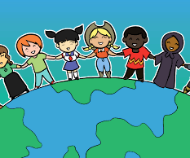
Diversity (of identity and experience) and Culturally Appropriate/Safe provision
Diversity means recognising the experiences and needs that come with race, ethnicity, gender and language, thereby incorporating many understandings of distress and seeking multi strengths based solutions in relation to mental health promotion, wellbeing, access, experience of services, recovery and strengthening community responses.

Slide 15
Informed by a social model of disability
The social model looks at how society is structured and how it disables people. It isn’t based on a person’s impairment, it is about what barriers that exist in terms of attitudes, policy development, access or lack of supports that prevent people from participating in society as equals, with choice and control over their own lives. In this model it is society that disables people from achieving their hopes and dreams, not a person’s impairment.
The medical / charity model individualises disability and promotes the idea that people are disabled by their impairments or differences. The medical model always focuses on people’s impairments/deficits from a medical perspective. In some ways it still looks at what is ‘wrong’ with the person and not what the person needs. It creates low expectations and leads to people losing independence, choice and control in their own lives.
The social model focuses on rights, particular rights in the UNCRPD* the right of people to have control over their lives, their decision, their access to services including medical care. The right to make decisions including the rights to make bad decisions. Disabled people are deemed to have capacity in the first instance and where they are deemed not to have capacity for a time the UNCRPD advocates supports to be put in place to support their decision making.
*The social model of disability informs key International Conventions such as the UN Convention of the Rights of People with Disabilities (UNCRPD) and is in contrast to the “medical / charity model” of disability.

Slide 16
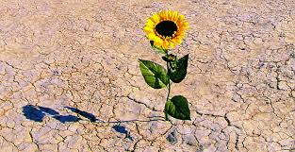
Recovery

